Slide 1
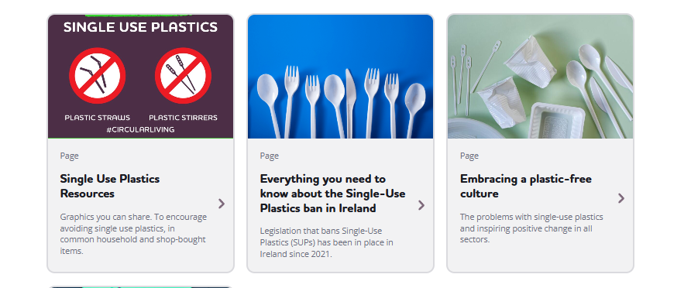
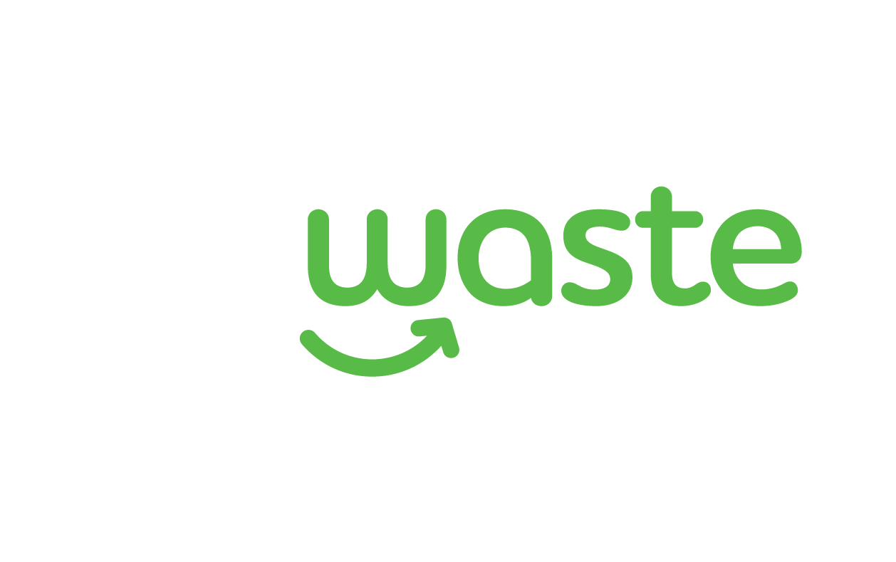
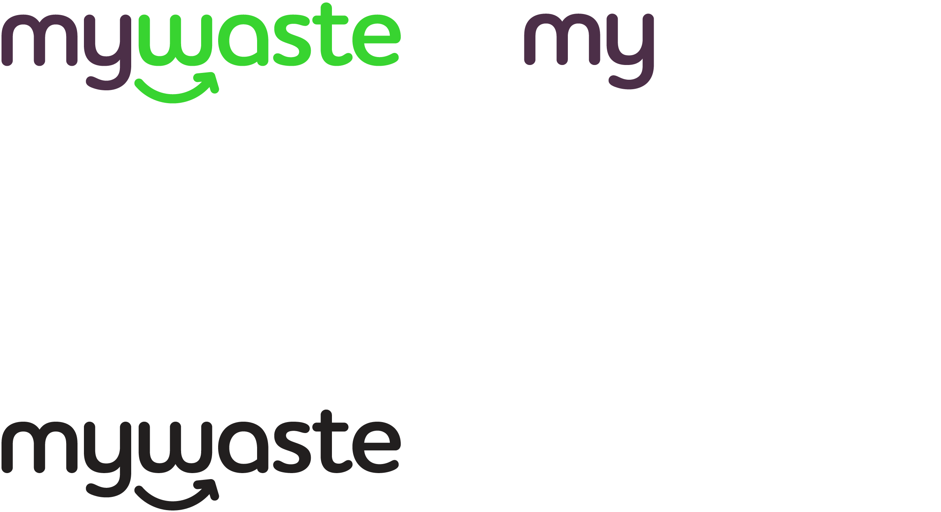
Single Use Plastics
[INSERT your LA Logo
here if required – or delete]

Slide 2
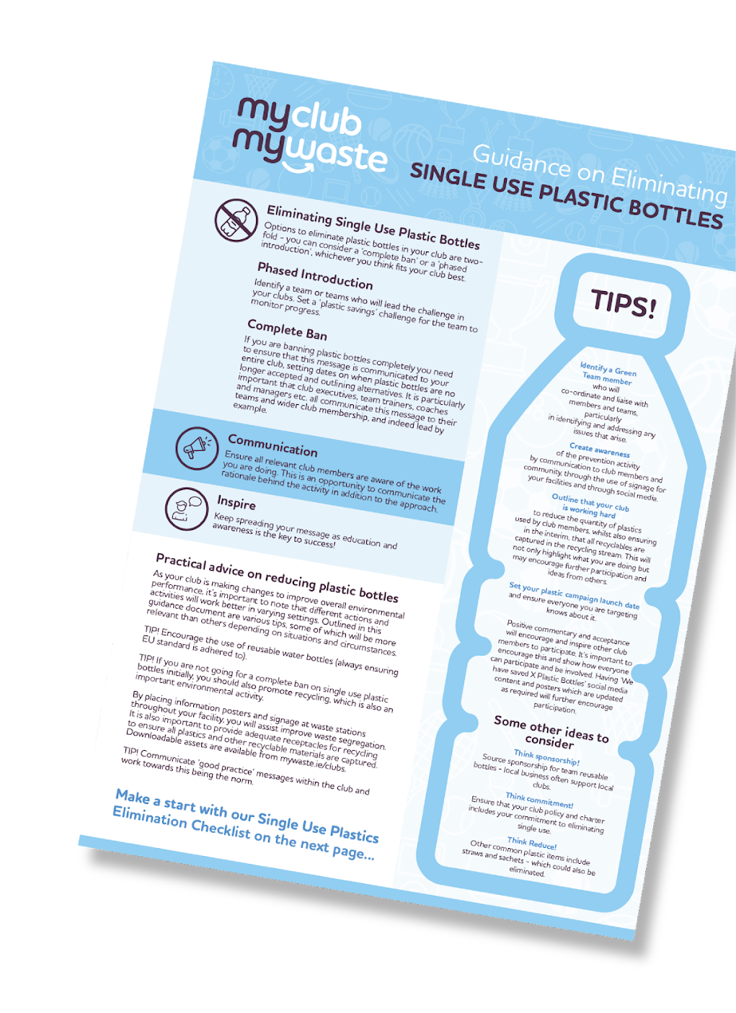
What are Single Use Plastics
  Single Use Plastics (SUP) are plastic products that are only used once, or for a short time, before being disposed of.
  Straws
  *Expanded polystyrene single use food containers
  Expanded polystyrene single use beverage containers
  **All oxo-degradable plastic products
  Cutlery (forks, knives, spoons)
  Chopsticks
  Plates
  Cotton bud sticks
  Drinks Stirrers
  Balloon Sticks
[INSERT your LA Logo
here if required – or delete]
[INSERT your LA Logo
here if required – or delete]

Slide 3
MyWaste
[INSERT your LA Logo
here if required – or delete]
[INSERT your LA Logo
here if required – or delete]

Slide 4
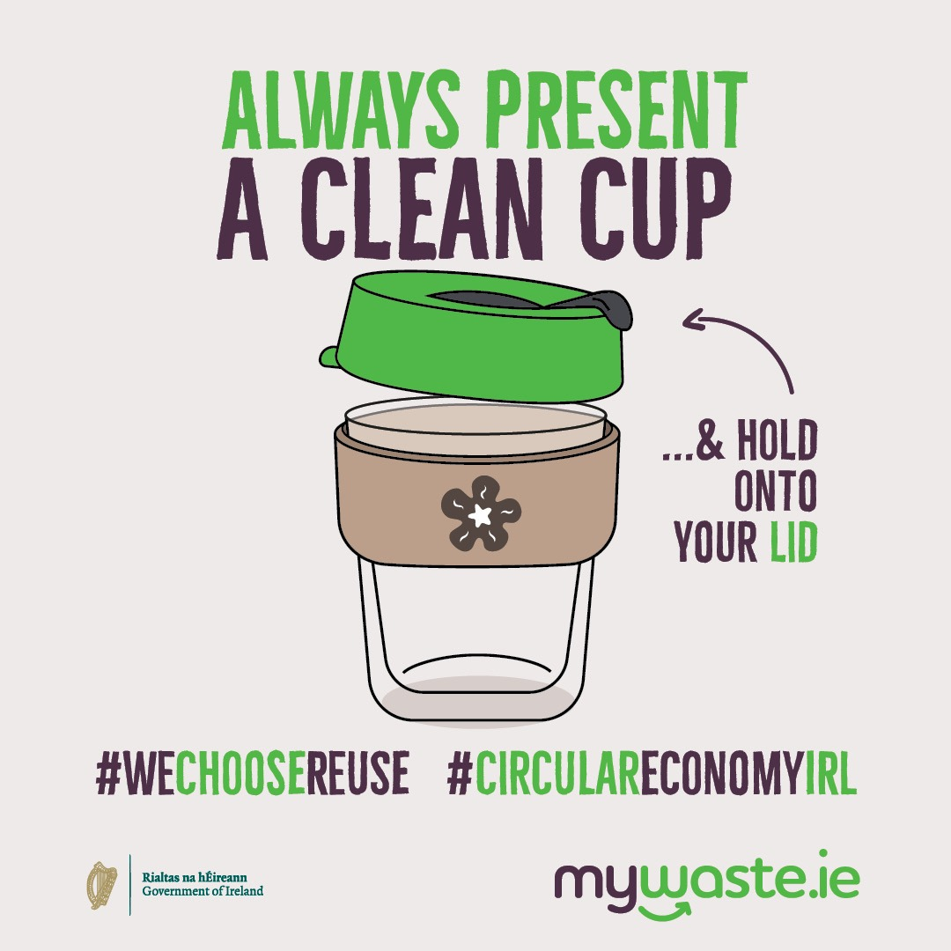
Options
  Replace SUP items with alternatives
  Reusable
  Cutlery (forks, knives, spoons)
  Plates
  Straws
  Cups
[INSERT your LA Logo
here if required – or delete]
[INSERT your LA Logo
here if required – or delete]

Slide 5
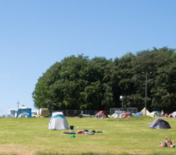
Options
mywaste.ie/sustainability/plastics/your-guide-to-plastic-free-festivals-and-events/
[INSERT your LA Logo
here if required – or delete]

Slide 6
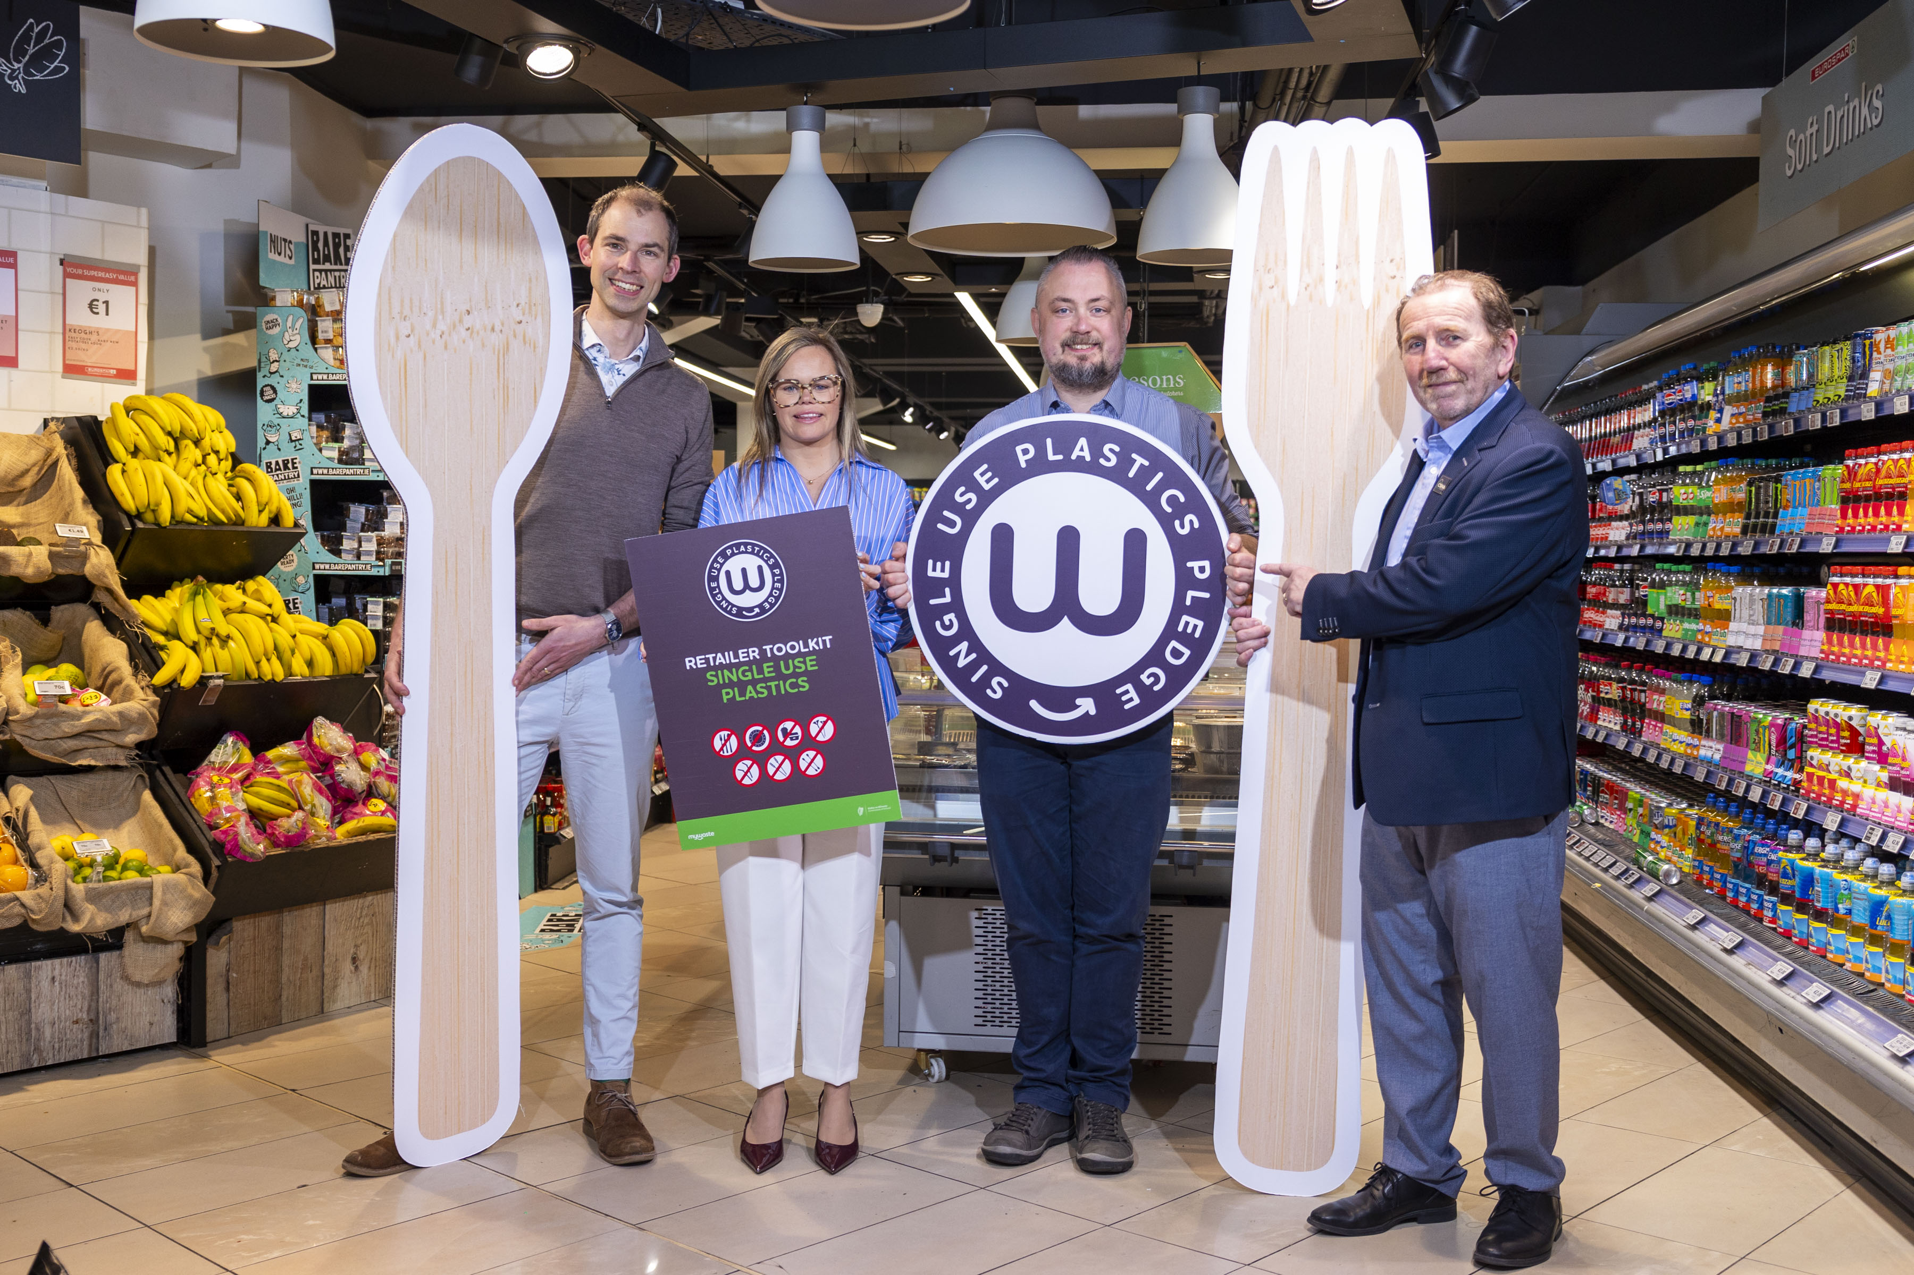
Options
[INSERT your LA Logo
here if required – or delete]
Notes:
The Single Use Plastics Directive took effect in Ireland in July 2021.
MyWaste has conducted research and found that only 50% of businesses are unaware of SUP regulations.
Strong industry by in from membership bodies Ibec, CSNA, Retail Excellence and RGDATA who pushed the message out to all of their members and encouraged the download of a free retailer SUP checklist. This free download is available in the resources section of mywaste.ie/

Slide 7
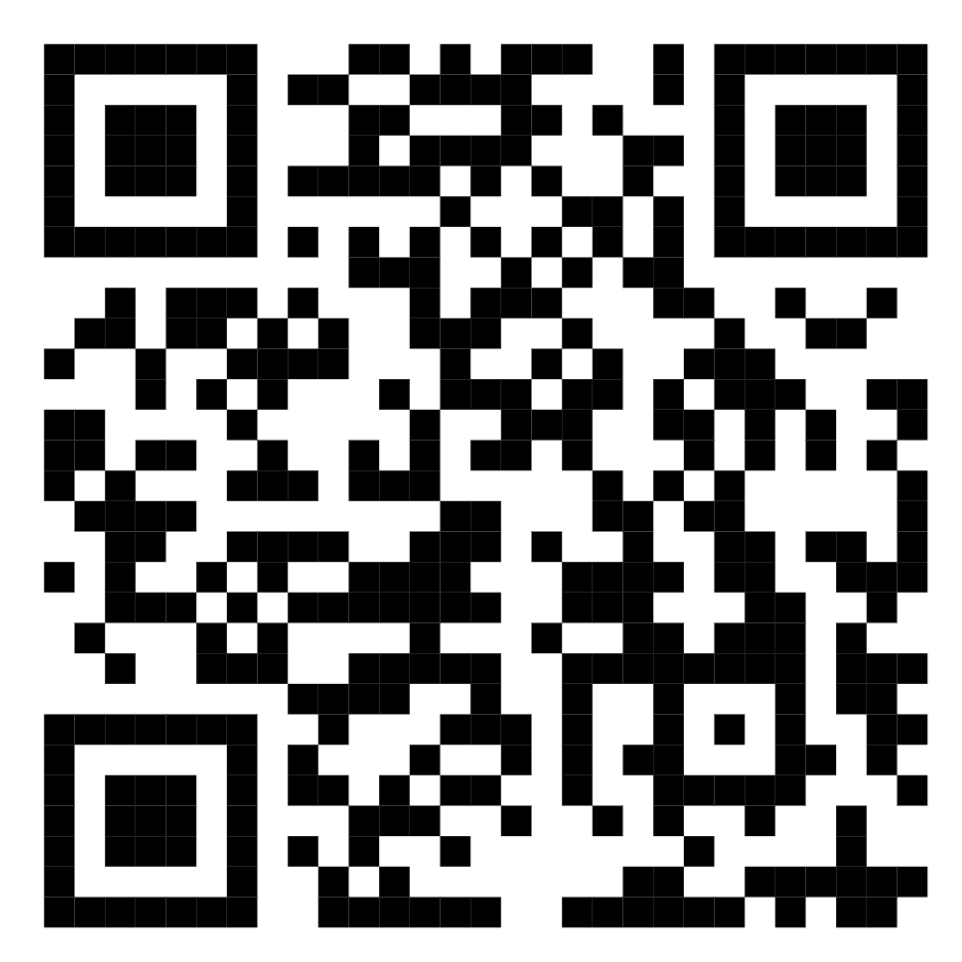
Options
MyWaste has a toolkit to help businesses check for banned items
in their stock and catalogues – free to download.
Toolkit can be signed after use for addition to company records
Link to toolkit download
[INSERT your LA Logo
here if required – or delete]
Notes:
- 10 banned single use plastic items are:
cutlery, chopsticks, straws, cotton bud sticks, plates, polystyrene food containers, polystyrene drink containers, balloon rods and all oxo-degradable plastic products.
- While awareness is low, compliance is high, at 96% so to eliminate the final instances of these banned single use plastics in Ireland we want to encourage all businesses to download this toolkit and ensure none are persisting for sale or supply through their offerings.
Single use plastics are difficult to recycle due to their size and end up as litter in our environments and waterways, contributing a major source of ocean plastics..
Plastics break down, without degrading, into microplastics when bumped or exposed to UV light, hot and cold temperatures. Micro plastics often bind with toxins and are ingested by animals, becoming part of the food chain and are now found in animal and human tissues alike.
Plastics should be avoided where possible and reusables should be sought, like reusable coffee cups, refillable food containers, and metal cutlery.
You might see ‘reusable’ printed on items like plastic cutlery but as most people admit to not reusing these products and them often not being made differently to disposable ones, this does not necessarily constitute them being reusable.

Slide 8
Single Use Plastics
Resources
& Assets
Click HERE
[INSERT your LA Logo
here if required – or delete]

